Slide 1


Lend a Hand
LifeMatters can suggest ways to offer support during a difficult time.
Call 24/7/365.
1-800-634-6433 • mylifematters.com

Slide 2

News Overload
If you are anxious about an event in the news, LifeMatters can help.
Call 24/7/365.
1-800-634-6433 • mylifematters.com

Slide 3

January Webinar
Energy Management
Available on mylifematters.com in January
Sign up for an email alert
1-800-634-6433 • mylifematters.com

Slide 4

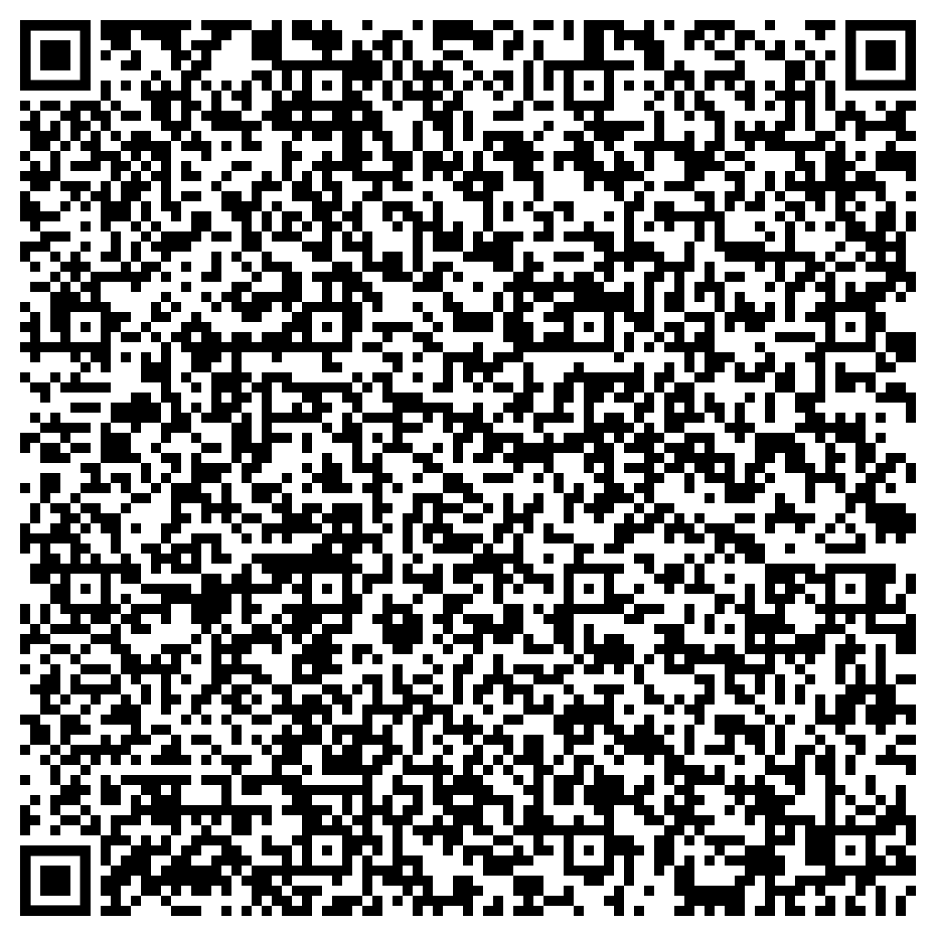
Jumpstart Your Health
and Wellbeing in 2024
Support session from LifeMatters
Tuesday, January 9
1 p.m. EST
Session password: Z5m2MpgADv5

