Slide 1


Solutions
LifeMatters offers 24/7/365 assistance with:
Creating healthy habits
Building relationships
Solving problems
Managing time and energy
Any other concern
1-800-634-6433 • mylifematters.com

Slide 2

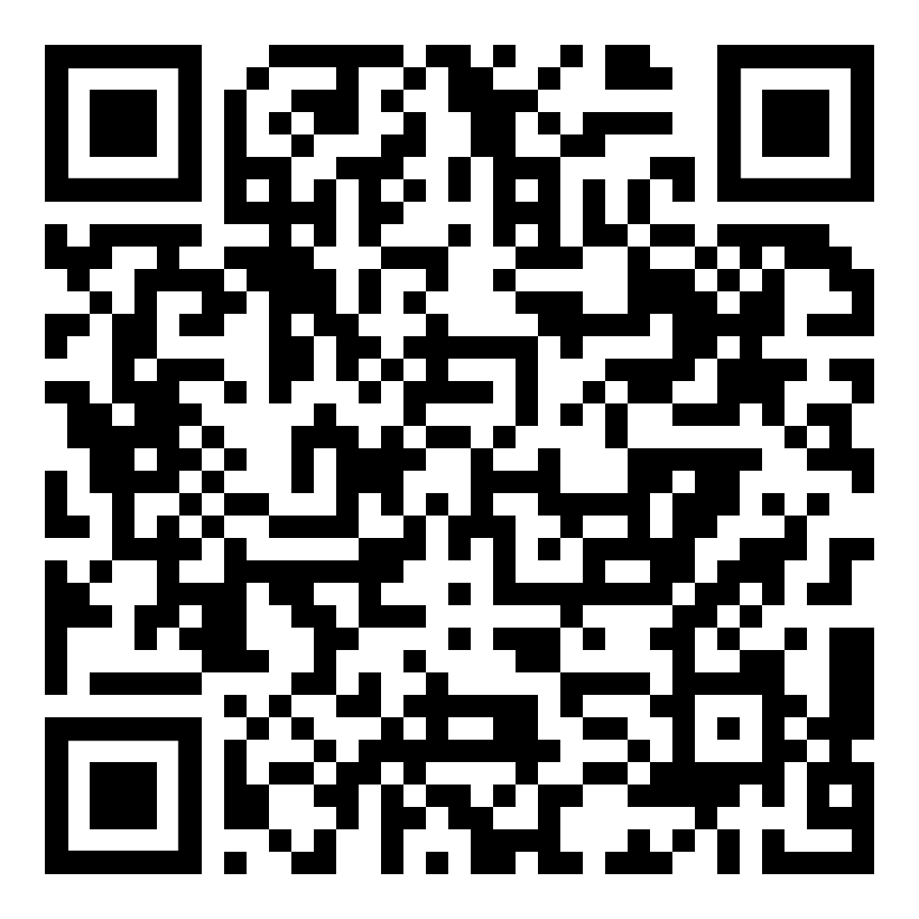
February Webinar
Communication Between Generations
Available on mylifematters.com in February
Sign up for an email alert
1-800-634-6433 • mylifematters.com

Slide 3

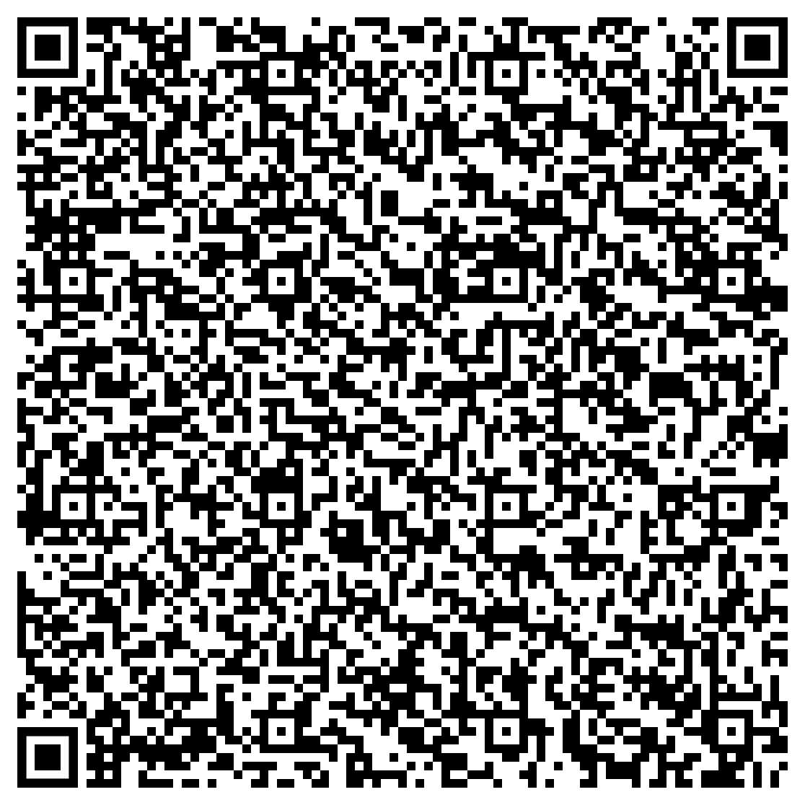
Power of Forgiveness
Support session from LifeMatters
Tuesday, February 13
1 p.m. EST
Session password:
aKvpxpmp243

