Slide 1


Identity
Theft
LifeMatters can help you recover from identity theft.
Call 24/7/365.

Slide 2
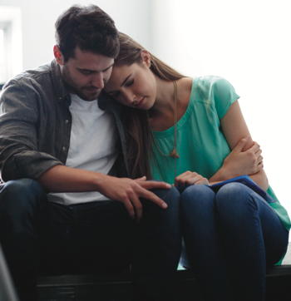
Struggling
If someone you care about needs emotional support, LifeMatters can help.
Call 24/7/365.

Slide 3
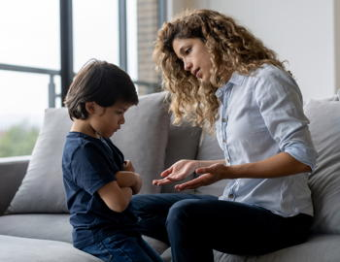
September Webinar
Discipline and Parenting
Available on mylifematters.com in September
Sign up for an email alert on the “Upcoming Webinars” page (under “Quick Links”)

Slide 4

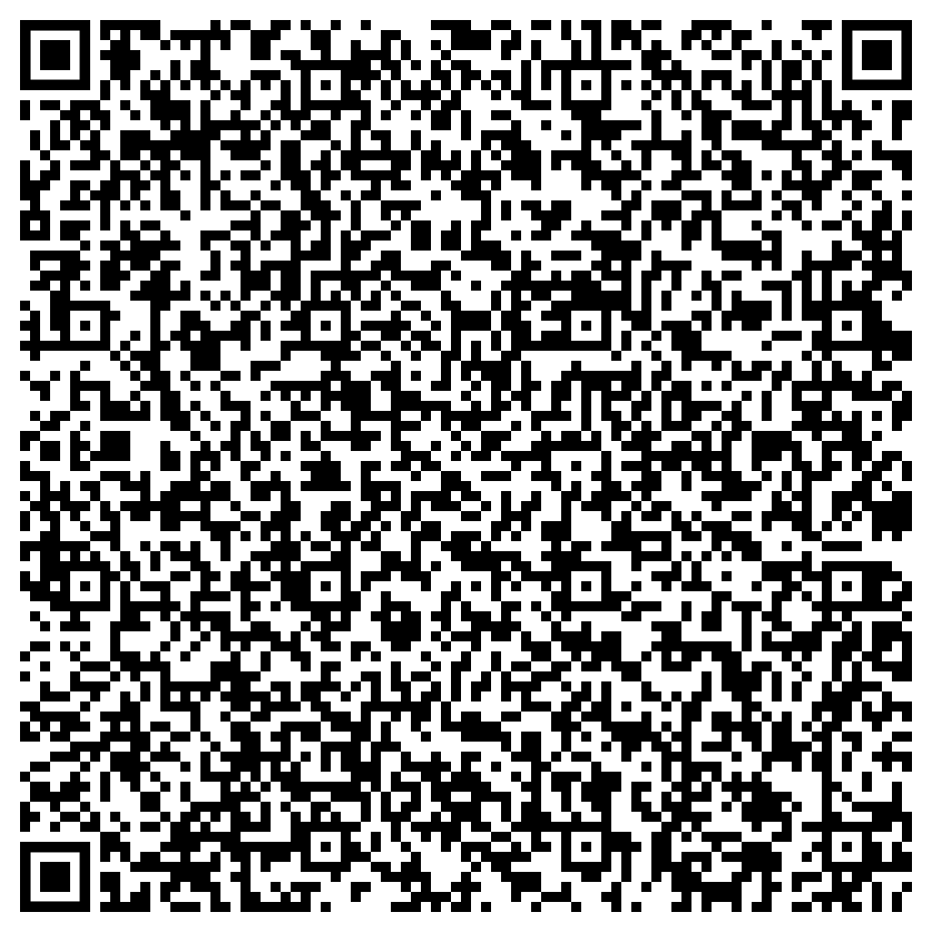
Tips for Living a Simpler, Happier Life
Support session from LifeMatters
Thursday, September 21
1 p.m. EDT
Session password: G6ZmQrkrN57

