Slide 1


Distracted
If you find it difficult to concentrate when you are nervous, LifeMatters can help.
Call 24/7/365.

Slide 2
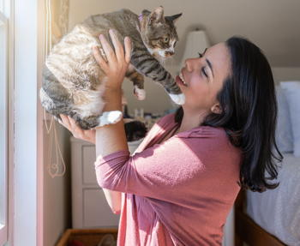
Pet Adoption
LifeMatters can help you determine if it’s the right time to adopt a pet.
Call 24/7/365.

Slide 3
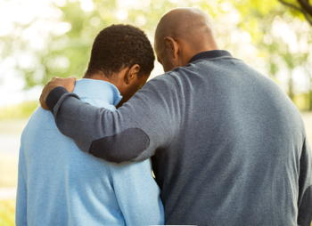
October Webinar
How to Deal with Depression in Your Family
Available on mylifematters.com in October
Sign up for an email alert on the “Upcoming Webinars” page (under “Quick Links”)

Slide 4

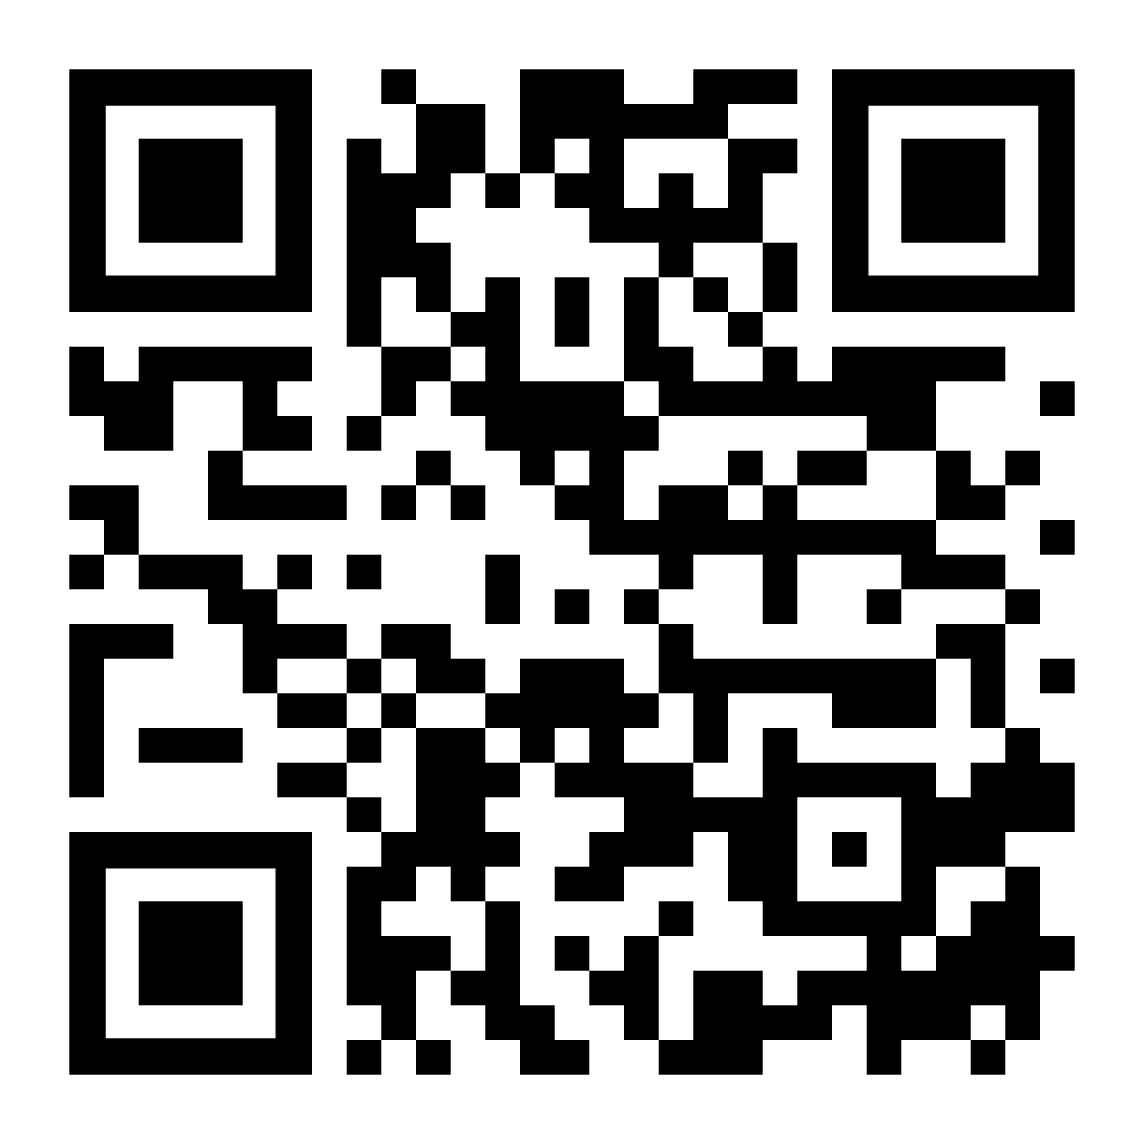
World Mental Health Day:
Recognizing & Combating Mental Health Issues
Support session from LifeMatters
Tuesday, October 10
2 p.m. EDT
Session password: Ycd7hyMpr37

