Slide 1


Connecting
LifeMatters offers 24/7/365 assistance with:
Improving parenting skills
Strengthening a relationship
Building rapport with colleagues
Increasing your EQ
Any other concern
1-800-634-6433 • mylifematters.com

Slide 2

November Webinar
Mindfulness
Available on mylifematters.com in November
Sign up for an email alert on the “Upcoming Webinars” page (under “Quick Links”)
1-800-634-6433 • mylifematters.com

Slide 3

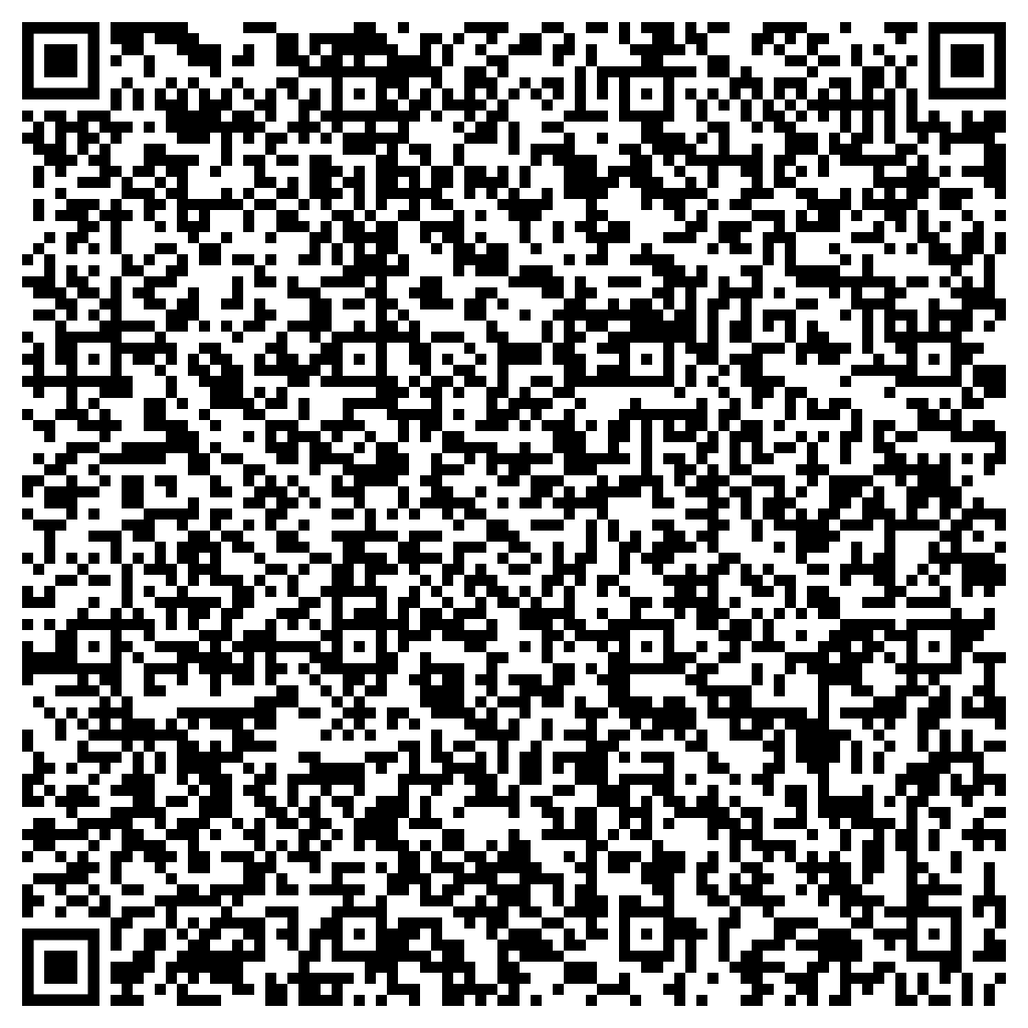
How to Be a
Working Caregiver
Support session from LifeMatters
Wednesday, November 15
1 p.m. EST
Session password:
EWuswKG3272

