Slide 1


Life Balance
LifeMatters offers 24/7/365 assistance with:
Improving wellbeing
Adapting to change
Building resilience
Setting healthy boundaries
Any other concern
1-800-634-6433 • mylifematters.com

Slide 2

May Webinar
Coping with Grief and Loss
Available on mylifematters.com in May
Sign up for an email alert on the “Upcoming Webinars” page (under “Quick Links”)
1-800-634-6433 • mylifematters.com

Slide 3

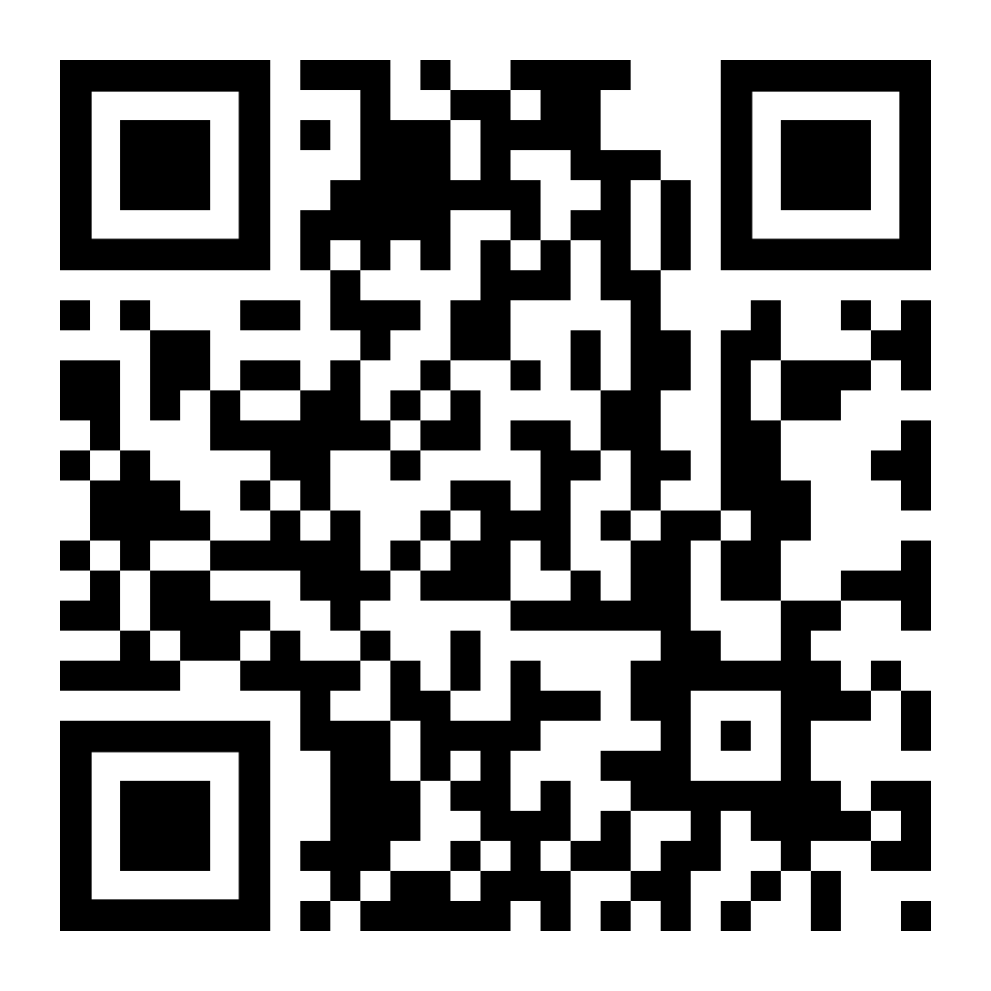
Women’s Mental Health
Support session from LifeMatters
Tuesday, May 23
1 p.m. EDT
Go to: https://mylifematters.com/hop/ip
Session password: VDp69UbNYV6

