Slide 1


LGBTQIA+ Support
LifeMatters can address the unique needs of LGBTQIA+ people.
Call 24/7/365.

Slide 2
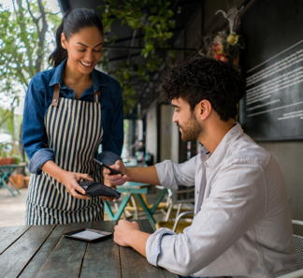
Per Diem
LifeMatters can help you set limits on your vacation spending.
Call 24/7/365.

Slide 3
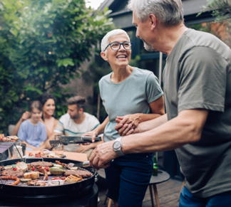
June Webinar
The Best Summer Ever!
Available on mylifematters.com in June
Sign up for an email alert on the “Upcoming Webinars” page (under “Quick Links”)

Slide 4
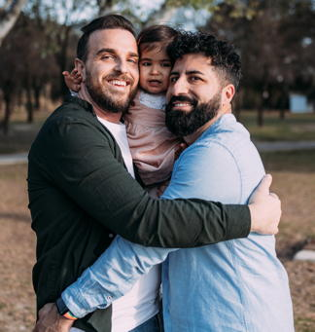
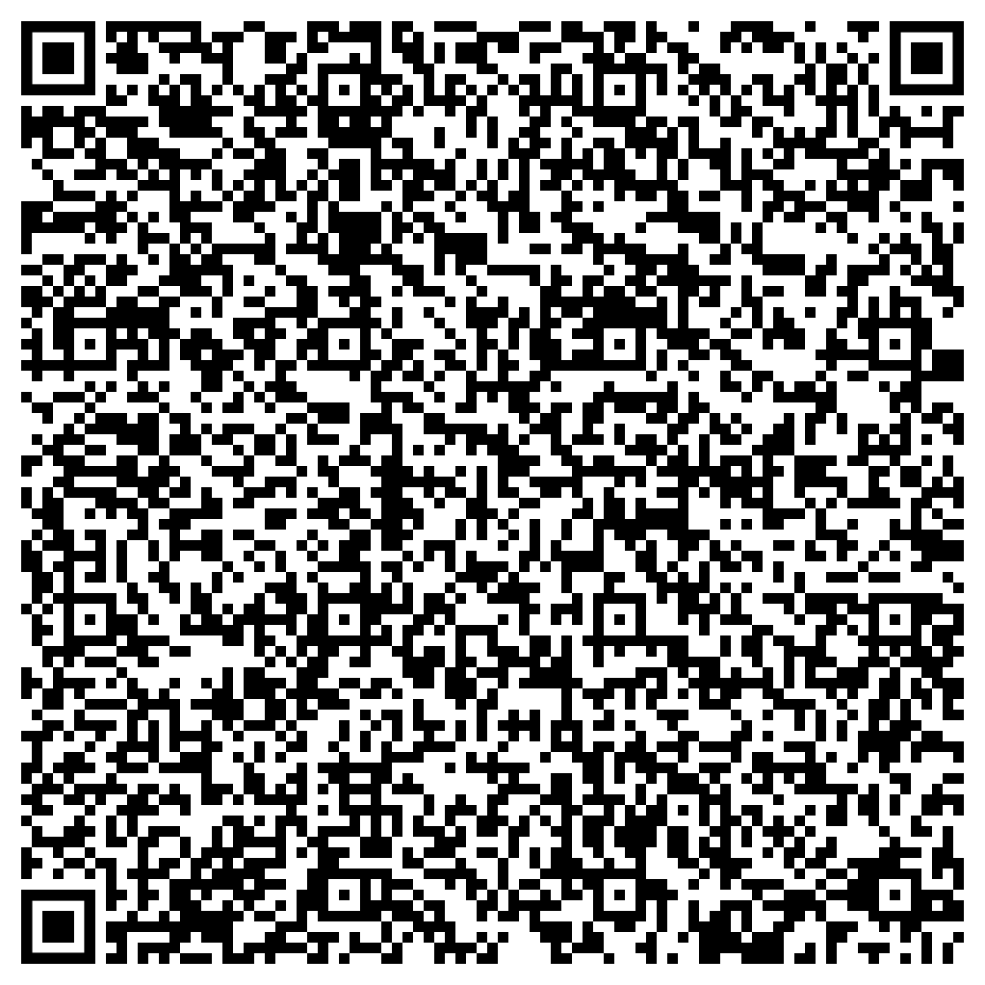
How to Be an Ally to
the LGBTQI+ Community
Support session from LifeMatters
Tuesday, June 20
1 p.m. EDT
Session password:
ghBYda6Rs39

