Slide 1


Holiday Blues
LifeMatters can help you cope with a change in holiday traditions.
Call 24/7/365.
1-800-634-6433 • mylifematters.com

Slide 2

Gratitude
LifeMatters can help you stay focused on the good stuff.
Call 24/7/365.
1-800-634-6433 • mylifematters.com

Slide 3

December Webinar
Handling Disagreements at Work
Available on mylifematters.com in December
Sign up for an email alert on the “Upcoming Webinars” page (under “Quick Links”)
1-800-634-6433 • mylifematters.com

Slide 4

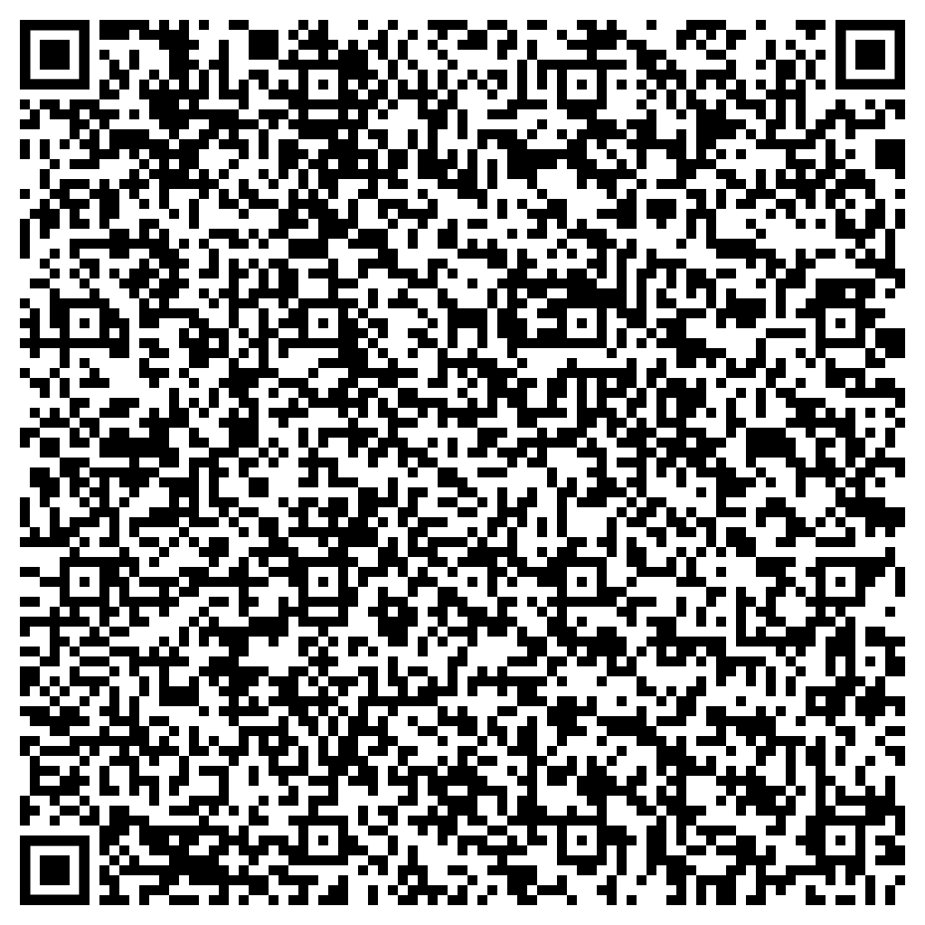
Creating Meaningful Holidays
Support session from LifeMatters
Thursday, December 7
1 p.m. EST
Session password: JCthHxip383

