Slide 1


Focus
LifeMatters offers 24/7/365 assistance with:
Improving concentration
Managing time
Eliminating distractions
Simplifying your to-do list
Any other concern

Slide 2

August Webinar
Becoming Your Own Advocate
Available on mylifematters.com in August
Sign up for an email alert on the “Upcoming Webinars” page (under “Quick Links”)

Slide 3

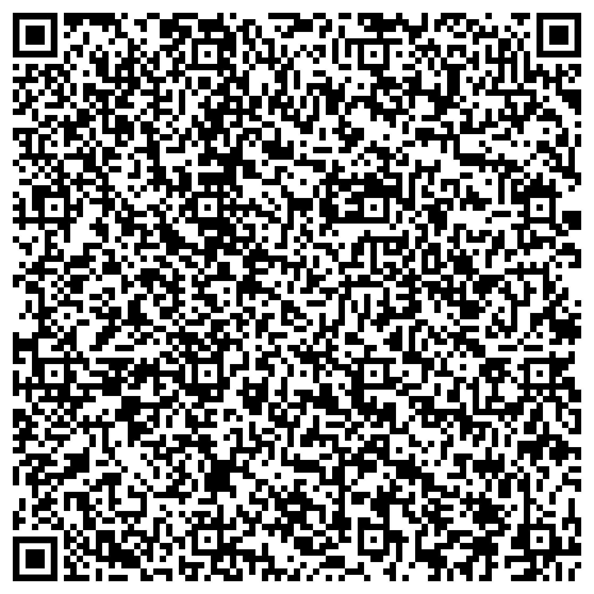
Mental Health Struggles:
How to Be There for a Friend or Family Member
Support session from LifeMatters
Thursday, August 30
1 p.m. EDT
Session password:
SKeVr3mau53

