Slide 1
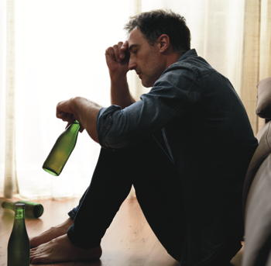

Getting Help
If alcohol or drugs are becoming a problem, LifeMatters can help.
Call 24/7/365.

Slide 2
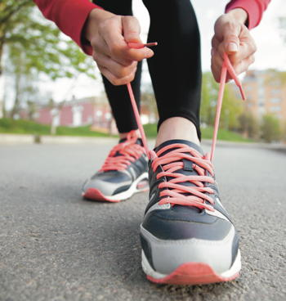
Lace Up!
LifeMatters can suggest ways to incorporate exercise into your daily routine.
Call 24/7/365.

Slide 3
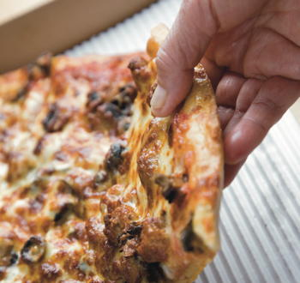
April Webinar
Emotional Eating
Available on mylifematters.com in April
Sign up for an email alert on the “Upcoming Webinars” page (under “Quick Links”)

Slide 4

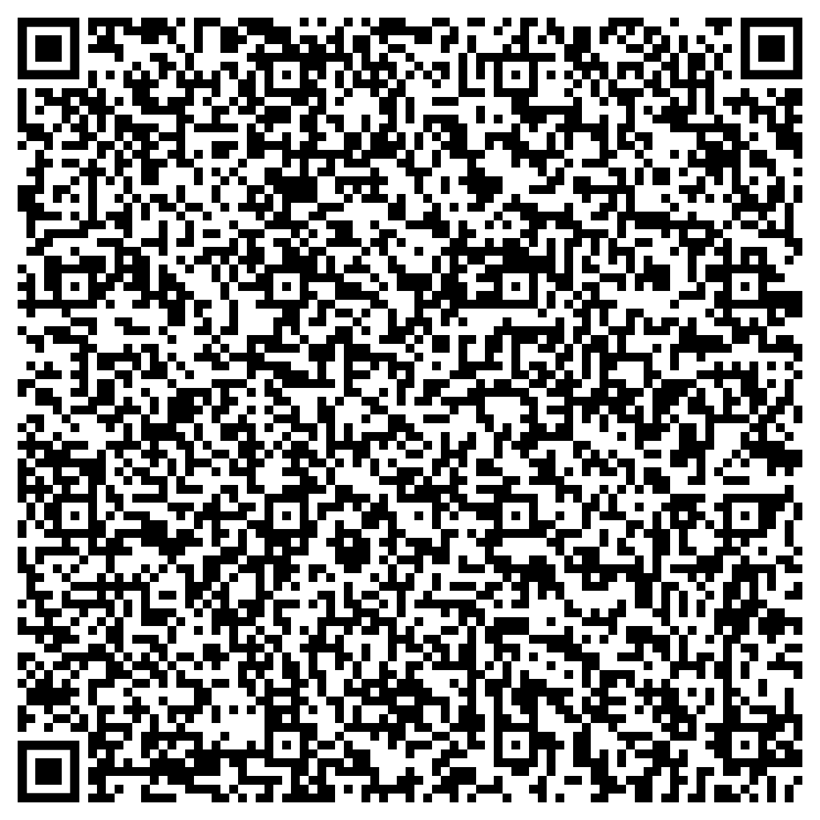
Daily Practices to Increase Mental Wellness and Prevent Burnout
Support session from LifeMatters
Wednesday, April 12
1 p.m. EDT
Go to: https://mylifematters.com/hop/in
Session password: MTtAgJgS336

